Slide 1

Due: Wed. two weeks later at 23:59:59
Filename: HW#_StuID.zip
  Ex) HW3_Q123456.zip
Introduction to Computers 1

Slide 2
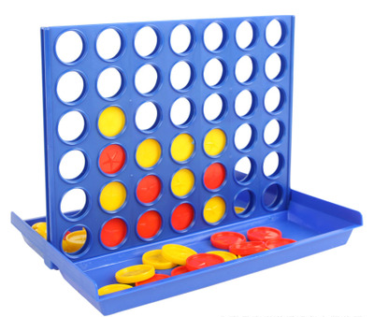

Rules
  6 rows, 7columns
  Two players
  21 red discs and 21 yellow discs
  Every round, players drop one of their discs into an unfilled column
  The player who achieves “four in a row” first is the winner
  If the game board fills before player achieve four in a row, the game is a draw
Introduction to Computers 1

Slide 3
Requirements:
  Write a program letting 2 users play Connect Four
  Use only basic rules
  Update and show the game board after each move
  When the game ends, determine and show which player is the winner or the game is a draw
  Include a “README.txt” to instruct how to play your game
Introduction to Computers 1

